Slide 1
New NOTEBOOK!!
My Numbers Interactive Notebook

Slide 2
Indices
Miss L
Year 7

Slide 3
Learning Intentions
Students will be able to
Correctly label an indices

Slide 4
Power-write
Write proper sentences about what you know about numbers.
Some things to think about:
  What kind of numbers are there?
  What do you know about prime numbers?
  What do you know about factors?
The person with the most amount of words after 2 minutes will get 20 VIVO points.

Slide 5
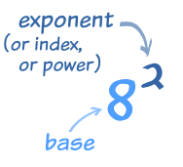
24
7
30
Indices
Date:
EQ – How do we put numbers in index and factor form?
What is Index Form?
The index of a number says how many times to use the number in a multiplication.
It is written as a small number to the right and above the base number.
The plural of index is indices.
(Other names for index are exponent or power.)

Slide 6


Slide 7
24
7
30
Indices
Date:
EQ – How do we put numbers in index and factor form?
What is Factor Form?
Factor from is the expanded version on an Index.
It is written as a series of multiplications
3 x 3 x 3 x 3 x 3

Slide 9



24
7
30
Indices
Date:
EQ – How do we put numbers in index and factor form?
Examples of Factor Form
Examples of Index Form
4 x 4 x 4
$$4^{3}$$
$$6^{5}$$
6 x 6 x 6 x 6 x 6
$$2^{9}$$
2 x 2 x 2 x 2 x 2 x 2 x 2 x 2 x 2

Slide 10
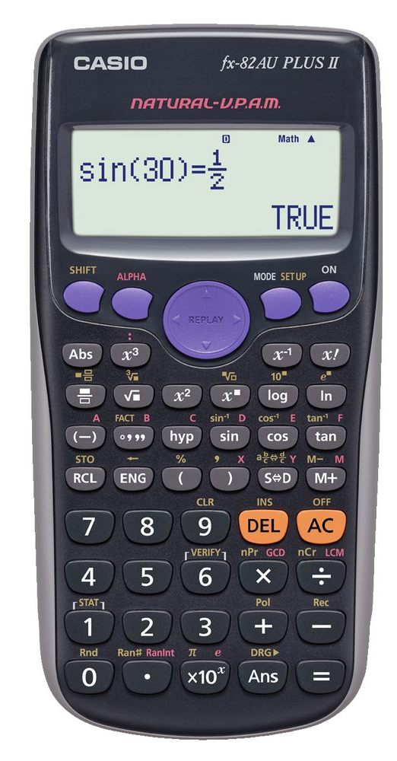
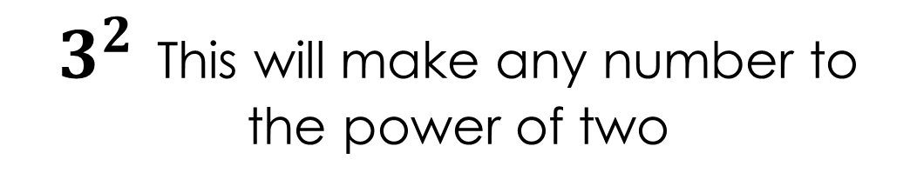
How to work it out on the calculator
$3^{2}$ This will make any number to the power of two

Slide 11
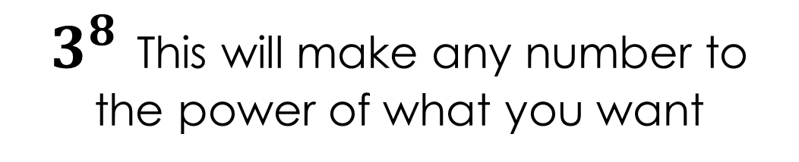
How to work it out on the calculator
$3^{8}$ This will make any number to the power of what you want

Slide 12
Card Indices
I will hand out each person a playing card.
When I say go you need to find all the other people with the same card as you and write your numbers in index form and factor form on the board
Once you are done sit down on the floor at the back of the room.
Notes:
You will need two playing cards. Make note of how many cards you hand out

Slide 13
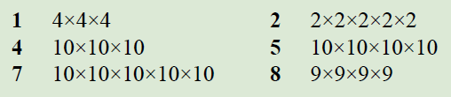
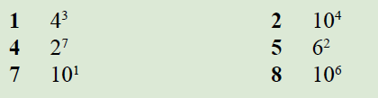
Practice
Notes:
Guide students through the question.
Option 2: Dot plots handout (Scaffolded for kids who may need extra help)

Slide 14
Task
Complete the worksheet
Notes:
Guide students through the question.
Option 2: Dot plots handout (Scaffolded for kids who may need extra help)

